Slide 1
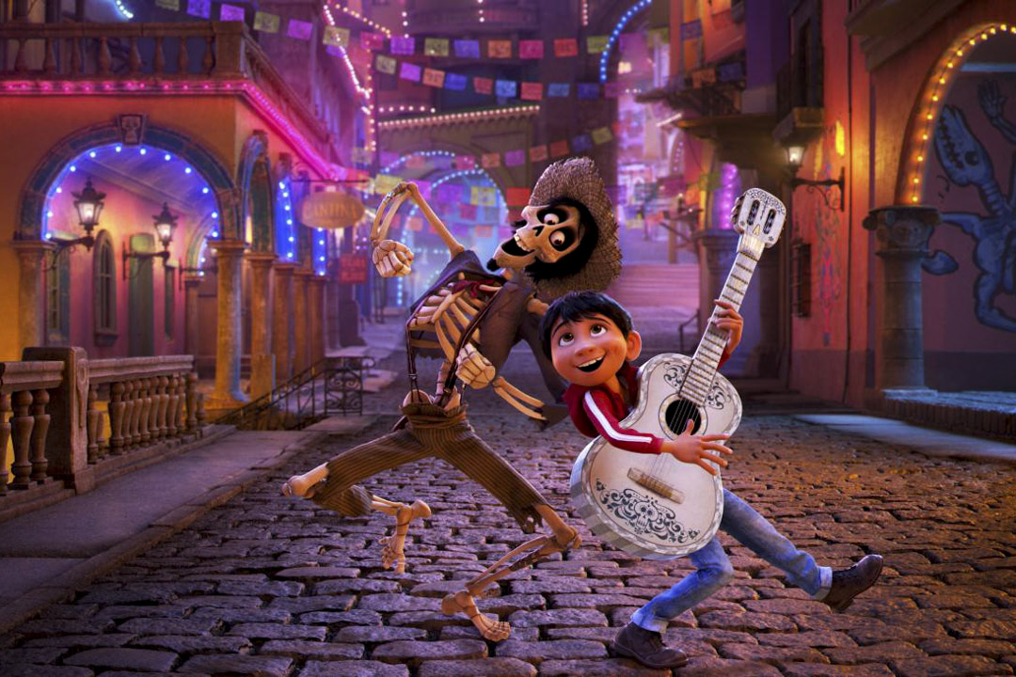
Yes, I am.
Are you tall and thin?

Slide 3
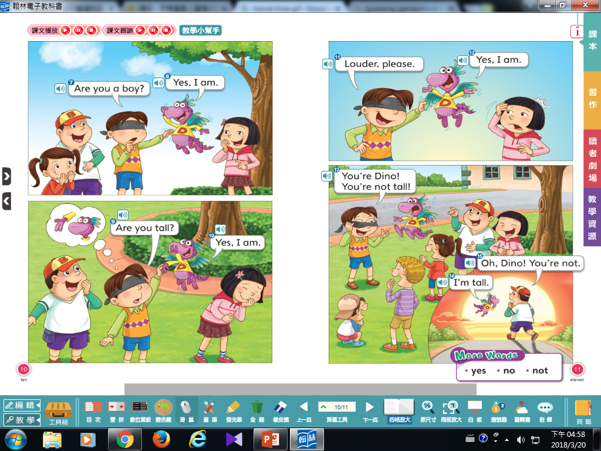

Slide 4
That’s right.

Slide 5
Louder, please.

Slide 7
-ed
-et

Slide 8
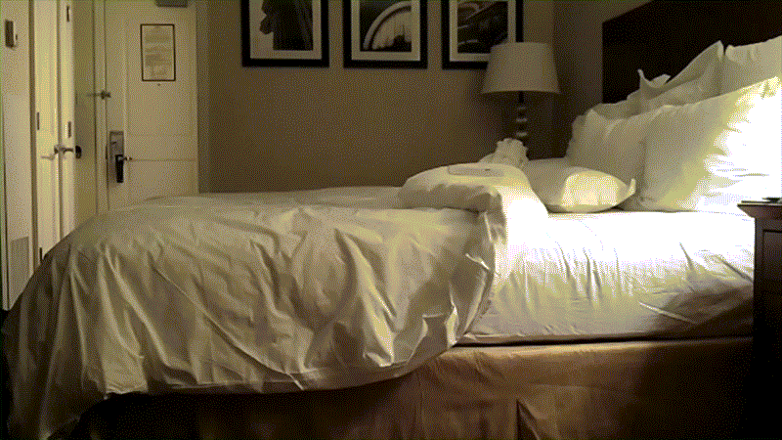
b
ed

Slide 9
r
ed

Slide 10
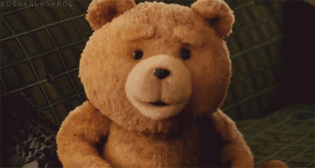
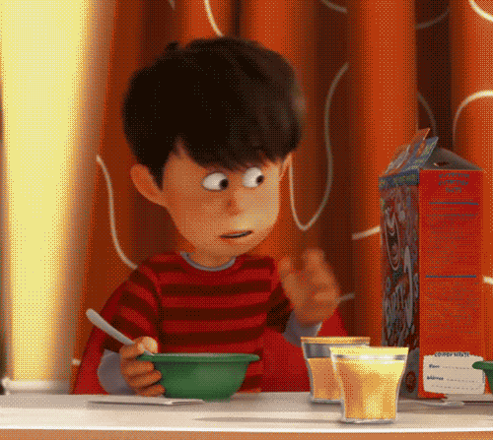
T
ed

Slide 11
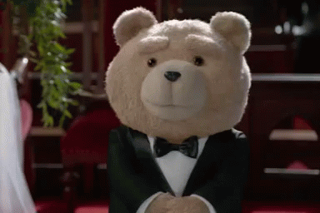
This is Ted.

Slide 12
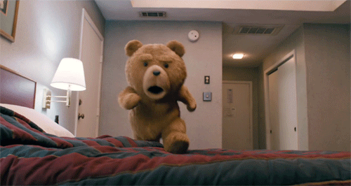
Ted has a bed.

Slide 13
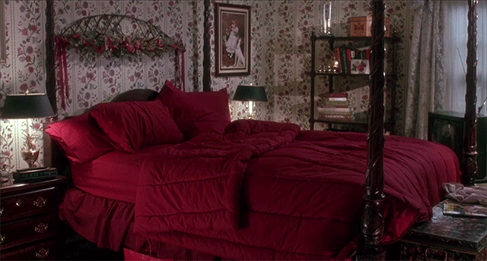
Ted has a red bed.

Slide 15
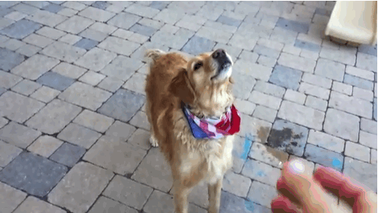
g
et

Slide 16
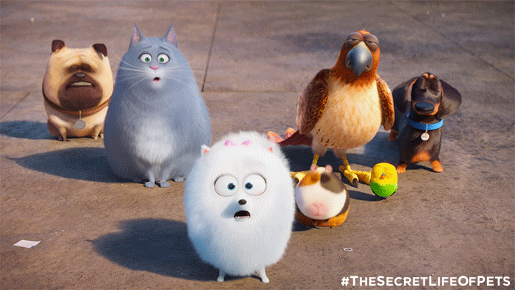
p
et

Slide 17
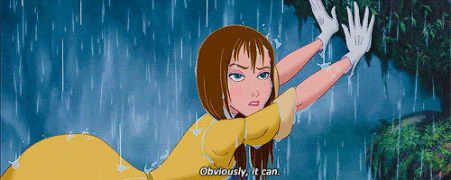
w
et

Slide 18
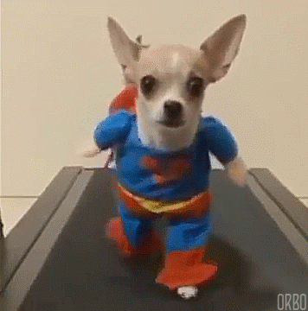
This is a pet.

Slide 19
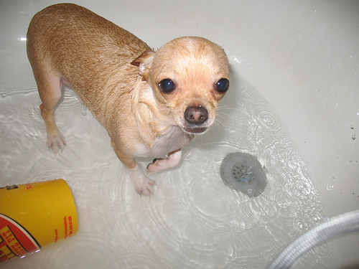
The pet is wet.

Slide 20
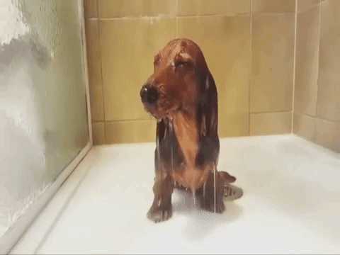
I get a wet pet.

Slide 22
-ad
-at

Slide 23
You are mad.

Slide 24
I am sad.

Slide 25
It’s bad to be mad and sad.

Slide 26
c
at

Slide 27
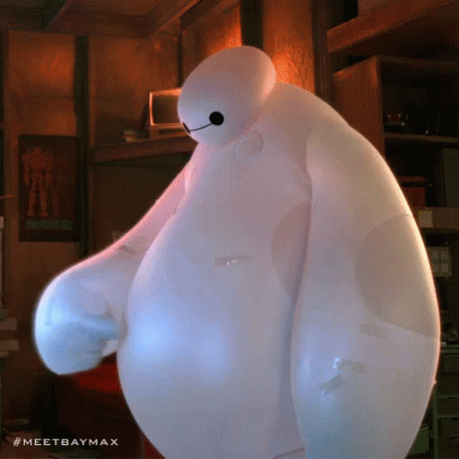
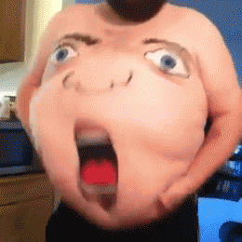
f
at

Slide 28
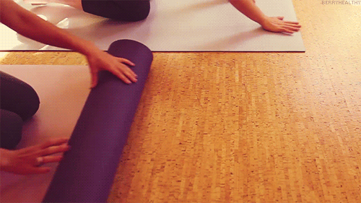
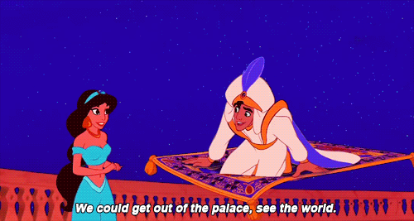
m
at

Slide 29
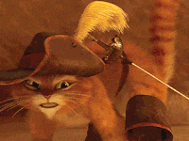
It’s a cat.

Slide 30
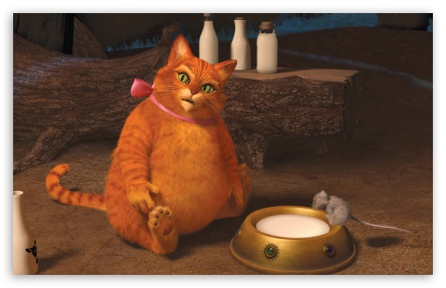
The cat is fat.

Slide 31
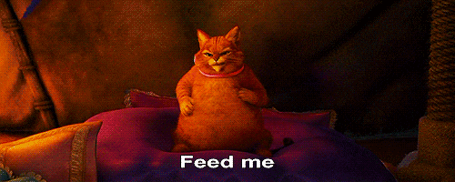
The fat cat is on a mat.

Slide 32
【本週英語作業】
1.聆聽和跟讀英語 CD
2.完成英文習作P45~P47。
3.完成讀寫練習本P5~P8。
4.背Unit 1&Unit 2的單字。

Slide 33
